Slide 1
Programming Language Code
A programming language is a language that uses
Key words (specially defined words)
Syntax (grammar),
Punctuation that a computer understands.
Every instruction adds to the semantics of the program

Slide 2
The Compilation Process for Non-Java Programs
After writing a program, you'll normally want to have a computer perform the tasks specified by the program. Getting that to work is normally a two-step process:
Execute compile command,
Execute a run command.
When you perform a compile command, you tell the computer to translate the program's programming language instructions to a binary format (all 0's and 1's).
When you perform a run command, you tell the computer to read the binary-format instructions and perform the tasks specified by them.
The computer contains a special program called a compiler that's in charge of the compilation process.
If you submit programming language instructions to a compiler, the compiler translates them into binary-format instructions.
More formally, if you submit source code to a compiler, the compiler compiles the source code and produces object code as the result.
Source code is the formal term for programming language instructions.
Object code is the formal term for binary-format instructions.

Slide 3
The Compilation Process for Java Programs
Java source code
HelloKmit.java
Java compilers compile source code into bytecode.
javac HelloKmit.java
Bytecode
HelloKmit.class
When a Java program is run, the JVM translates bytecode to object code.
java HelloKmit
object code
The Java Virtual machine (JVM) is the virtual machine that run the Java bytecodes. The JVM doesn't understand Java typo, that's why you compile your *.java files to obtain *.class files that contain the bytecodes understandable by the JVM.

Slide 4
Creating and Compiling JAVA Programs
On command line
javac file.java

Slide 5
Executing Applications
On command line
java classname

Slide 6
Example
javac Welcome.java
java Welcome
output:...

Slide 7
Object Code
Object code is a set of binary-format instructions that can be directly run by a computer to solve a problem.
A binary-format instruction is made up of all 0’s and 1’s, because computers understand only 0’s and 1’s. Here's an example of an object-code instruction:
0100001111101010
This particular object-code instruction is referred to as a 16-bit instruction because each of the 0’s and 1’s is a bit, and there are 16 of them.
Each object-code instruction is in charge of only a simple computer task. For example,
Create another copy of a variable.
Initialize a variable etc
Programmers sometimes refer to object code as machine code. Object code is called machine code because it's written in binary and that's what a computer “machine” understands.

Slide 8
Portability
Is object code portable?
A piece of software is portable if it can be used on many different types of computers.
Object code is not necessarily portable.
As you know, object code is comprised of binary-format instructions.
Those binary-format instructions are intimately tied to a particular type of computer.
If you've got object code that was created on a type X computer, then the object code can run only on a type X computer.

Slide 9
Portability
The Java solution to improve portability:
Java compilers don't compile all the way down to object code.
Instead, they compile down to bytecode, which possesses the best features of both object code and source code:
Like object code, bytecode uses a format that works closely with computer hardware, so it runs fast.
But unlike object code, bytecode is generic, so it can be run on any type of computer.

Slide 10
Java Virtual Machine (JVM)
How can bytecode be run on any type of computer?
As a Java program’s bytecode runs, the bytecode is translated into object code by the computer's bytecode interpreter program. The bytecode interpreter program is known as the Java Virtual Machine, or JVM for short.
Java code compilation takes place in two stages.
Java compiler translates source code to bytecode
JVM translates bytecode to object code.
On command line
java classname

Slide 11
History of Java
How JAVA interact with web pages?
Web pages have to be very portable because they can be downloaded onto any type of computer.
What's the standard language used for Web pages?
Java programs are very portable and they're better than HTML in terms of providing user interaction capabilities.
Java programs that are embedded in Web pages are called applets.
Although applets still play a significant role in Java's current success, some of the other types of Java programs have surpassed applets in terms of popularity. They are:
Socket.io
Javascript
jQuery

Slide 12
Programming Style and Documentation
Appropriate Comments
Naming Conventions
Proper Indentation and Spacing Lines
Block Styles

Slide 13
Appropriate Comments
Why comments are useful?
Include a summary at the beginning of the program to explain:
what the program does,
its key features,
its supporting data structures, and
any unique techniques it uses.
Also it helps in:
Include your name,
class section,
instruction, date, and
a brief description at the beginning of the program.

Slide 14
Java Programming – Unit 1
Write the code using Notepad
Ensure that the extension is .java
Ensure that the class name and .java file name is same.
Example
//This is single line comment
/*
This is multi line
comment
*/
public class JU11Comment
{
public static void main(String[] args)
{
System.out.println("Welcome to Java !");
}
}

Slide 15
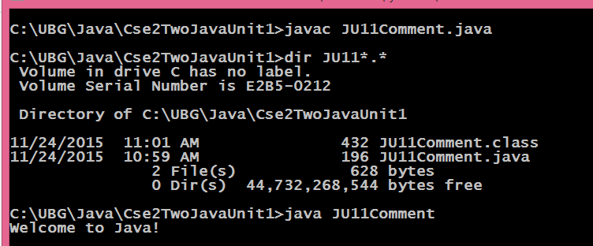
Java Programming – Unit 1
File name is JU11Comment.java
javac JU11Comment.java will compile the code.
If compilation is successful then in addition JU11Comment.java file JU11Comment.class file also gets created.
Execute the compiled file using java JU11Comment command.
If there are no errors in your source file, the Java compiler will produce one or more .class files (one .class file for each class defined in the Foo.java source file).
For example, the results of a successful compile of Foo.java will produce a byte-code version of the class in a file named Foo.class.
If there are more that once class then save each public class in separate .java and compile individually.

Slide 16
Naming Conventions
Choose meaningful and descriptive names.
Variables and method names:
Use lowercase.
If the name consists of several words, concatenate all in one, use lowercase for the first word, and capitalize the first letter of each subsequent word in the name.
For example, the variables radius and area, and the method computeArea.

Slide 17
Naming Conventions, cont.
Class names:
Capitalize the first letter of each word in the name.
For example, the class name ComputeArea.
Constants:
Capitalize all letters in naming a constants.
For example, the constant PI.

Slide 18
Proper Indentation and Spacing
Indentation
Indent two spaces.
Spacing
Use blank line to separate segments of the code.

Slide 19
Block Styles
Use
Next-Line style or
End-of-line style for braces.

Slide 20
Programming Errors
Syntax Errors
Detected by the compiler
Runtime Errors
Causes the program to abort program during run time.
Logic Errors
Produces incorrect result

Slide 21
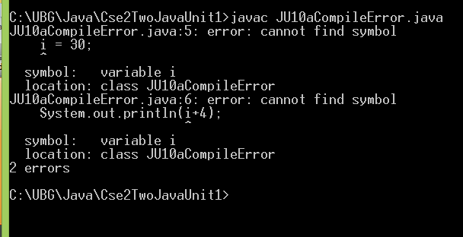
Compilation Errors
public class Fsa1
{
public static void main(String[] args)
{
i = 30;
System.out.println(i+4);
}
}

Slide 22
Logic Errors
import javax.swing.*;
public class ShowLogicErrors {
// Determine if a number is between 1 and 100 inclusively
public static void main(String[] args) {
// Prompt the user to enter a number
String input = JOptionPane.showInputDialog(null,
"Please enter an integer:",
"ShowLogicErrors", JOptionPane.QUESTION_MESSAGE);
int number = Integer.parseInt(input);
// Display the result
System.out.println("The number is between 1 and 100, " +
"inclusively? " + ((1 < number) && (number < 100)));
System.exit(0);
}
}

